Slide 1
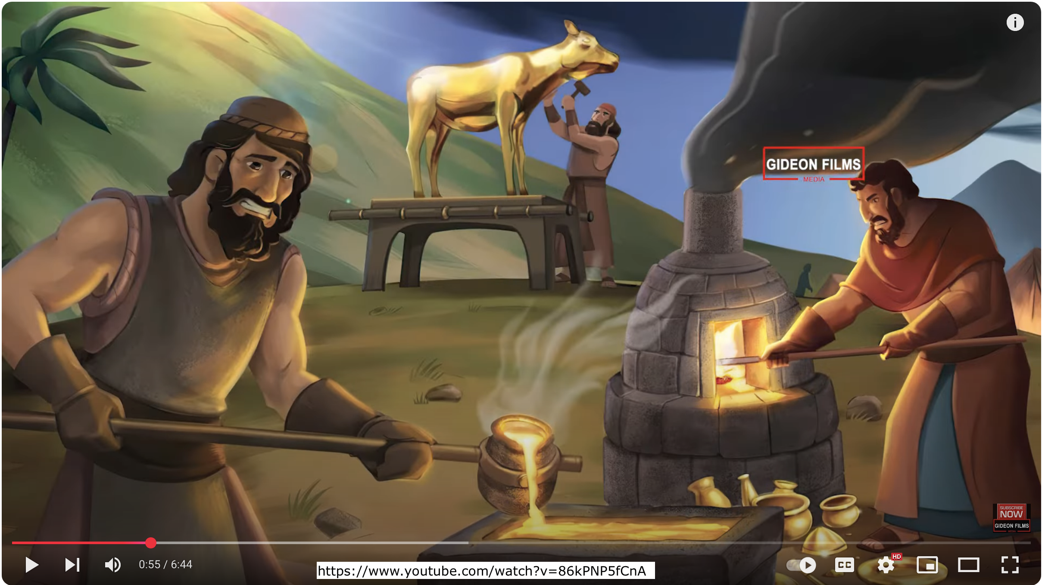
Exodus 出埃及記 32:01-10 Moses and Parenting: the Golden Calf
親子靈修 William分享
09-13-2025

Slide 2
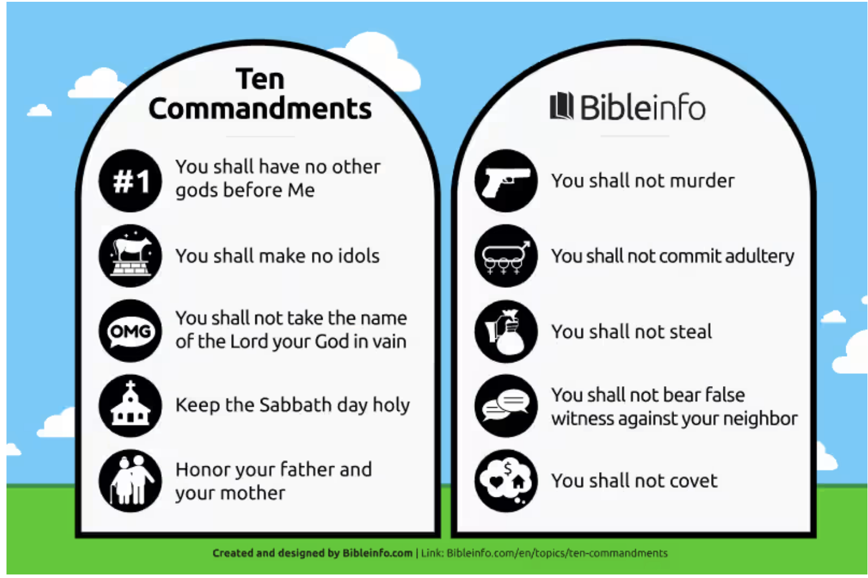
Do you remember the Ten Commandments? 出埃及記(Exodus) 16:32-36

Slide 3
https://www.youtube.com/watch?v=86kPNP5fCnA
English Version Video: Exodus 30:01-10.
(2 min)

Slide 4
Study Exodus 32 from the Parenting Perspective
# | Key Figures in Exodus 32 | Parenting Figures
1 | Moses | father
2 | Aaron | mother
3 | Israelites | children

Slide 5
Question to Children 1 (Exo32:1)
What was wrong with the Israelites in the desert?
- They missed Moses.
- They were worried about Moses.
- They felt lonely.
- They felt lost.
- They felt hungry.
- They felt bored.
- They were impatient.
- They were upset.
- …

Slide 6
Question to Children 2 (Exo32:1)
What kind of sin did the Israelites commit? (Exo32:1)
- They complained to Moses.
- They had gossip.
- They judged others.
- They argued with each other.
- They fought each other.
- They slaughtered each other.
- They wanted to make an idol: a golden calf.
- They wanted to make a god.
- …

Slide 7
Question to Parents (Exo32:2-5)
What did Aaron respond to the Israelites?
- He consoled them.
- He comforted them.
- He rejected them.
- He chided them.
- He beat them.
- He cursed them.
- He abided by them.
- …

Slide 8
Question to Parents and Children (Exo32:10)
What is the consequence of committing sin?
- funny.
- happy.
- pride.
- richer.
- encouraging.
- blessed.
- bittering, painful.
- cursed.
- death.
- …

Slide 9
個人反思 & 教養智慧
個人反思 Personal Reflection：
How to love children? But to prevent spoiling?
What is true love?
教養智慧：
"教养孩童、使他走当行的道、就是到老他也不偏离。" (Pro22:6 CUV)
"Train a child in the way he should go, and when he is old he will not turn from it." (Pro22:6 NIV)

Slide 10
Closing Prayer
Dear Heavenly Father, the Glorious Lord, the Creator, and Sovereign of all things. Thank you for your mercy and grace. Thank you for calling us, the parents. Thank you for giving us, the parents, the educational authority. Our children are your heritage. We are the sinners; we do not deserve it. May Your Holy Spirit call us, guide us. Bless our children and young generation to be able to know you, follow you to be the devotional generation. May your name be glorified, generation by generation, and forever. I pray in the name of Jesus. Amen.

Slide 11
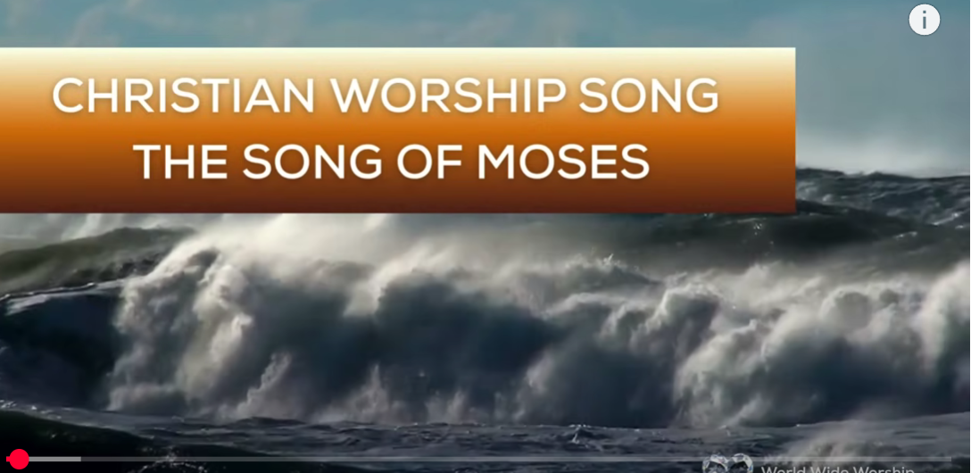
1.No Turning Back
https://www.youtube.com/watch?v=yNtid3wdDWA&list=RDyNtid3wdDWA&start_radio=1&ab_channel=GaiseBaba
Christian Kids
2. The Song of Moses https://www.youtube.com/watch?v=a-wWKL-7Mrg
The Song of Moses Like You've Never Heard Before | Christian Worship Song/ World Wide Worship
3. I Dependent on You
https://www.youtube.com/watch?v=c441z2h-_fE&list=RDc441z2h-_fE&start_radio=1

